Slide 1
CIS4930 Term Project
Team 1 (Eric Brown, Macguire Mcduff, Zachary Miller, Sihala Senevirathne, Julian Beloiu)

Slide 2
Introduction
Task centered around predicting student’s exam scores based on several factors such as hours studied, attendance, parental involvement, etc.
Significance
Can help educators better understand factors that affect student performance and provide support to students that are struggling
2 tasks: Regression and Classification
Regression: Predict a numerical exam score
Classification: Predict pass/fail (with 70 set as the cutoff for a passing grade)
Metrics used to evaluate models
Regression: MSE, RMSE, MAE, R²
Classification: Accuracy, Precision, Recall, F1 Score
Dataset:
https://www.kaggle.com/datasets/lainguyn123/student-performance-factors
Number of Features: 20
Number of Records: 6,607
Notes:
Sihala

Slide 3
Dataset Overview (Numerical Features)
Hours_Studied: Number of hours spent studying per week
Minimum: 1, Mean: 19.96, Max: 44
Attendance: Percentage of classes attended
Minimum: 60, Mean: 79.98, Max: 100
Sleep_Hours: Average number of hours of sleep per night
Minimum: 4, Mean: 7.03, Maximum: 10
Previous_Scores: Scores from previous exams
Minimum: 50, Mean: 75.07, Maximum: 100
Tutoring_Sessions: Number of tutoring sessions per month
Minimum: 0, Mean: 1.15, Maximum: 8
Physical_Activity: Average number of hours of physical activity per week
Minimum: 0, Mean: 2.97, Maximum: 6

Slide 4
Dataset Overview (Categorical Features)
Parental_Involvement: Level of parental involvement in the student’s education
Low, Medium, or High
Access_to_Resources: The availability of educational resources
Low, Medium, or High
Extracurricular_Activities: Whether the student participates in extracurricular activities
Yes or No
Motivation_Level: The student’s Level of motivation
Low, Medium, or High
Internet_Access: Whether the student had access to the internet
Yes or No
Family Income: Family income level
Low, Medium, or High

Slide 5
Dataset Overview (Categorical Features cont.)
Teacher Quality: Quality of the teachers
Low, Medium, or High
School Type
Public or Private
Peer_Influence: Influence of peers on academic performance
Positive, Neutral, or Negative
Learning_Disabilities: Presence of learning disabilities
Yes or No
Parental_Education_Level: Highest education level of parents
High School, College, Postgraduate
Distance_from_Home: Distance from home to school
Near, Moderate, Far
Gender
Male or Female

Slide 6
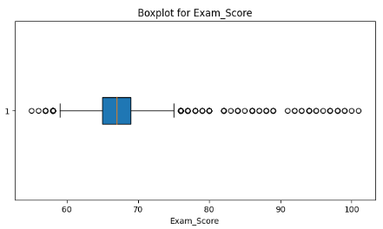
Dataset Overview (Target)
Exam_Score: Final Exam Score
Minimum: 55
1st Quartile: 65
Median: 67
3rd Quartile: 69
Maximum: 101
Mean: 67.24

Slide 7
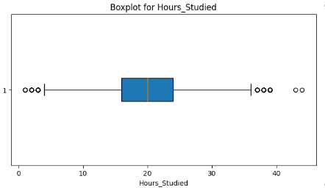
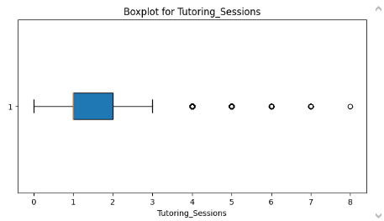
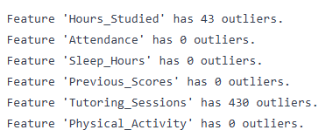
Exploratory Data Visualization (1) - Outliers
Checked the number of outliers in each numerical feature using a threshold of 1.5 IQR
Tested the performance of the models before and after removing the outliers
Removing the outliers decreased the performance of the regression models by a significant amount
As a result, we did not remove the outliers

Slide 8
Exploratory Data Visualization (2)
Based on the correlation heatmap (correlation with target exam score):
Moderate Correlation(>|0.30|):
Hours Studied (0.45)
Attendance (0.58)
Weak Correlation(|0.08|-|0.2|):
Parental Involvement(0.16)
Access to resources(0.17)
Previous Scores(0.17)
Motivation Level (0.09)
Tutoring Sessions(0.16)
Family Income (0.09)
Teacher Quality (0.08)
Parental Education Level(0.11)
No Correlation (<|0.08|):
Extracurricular Activities(0.06)
Sleep hours(-0.02)
Internet access(0.05)
School type (-0.01)
Physical Activity(0.03)
Gender(0.00)
Peer Influence (-0.10)
Learning Disability(-0.08)
Distance from home(-0.09)

Slide 9
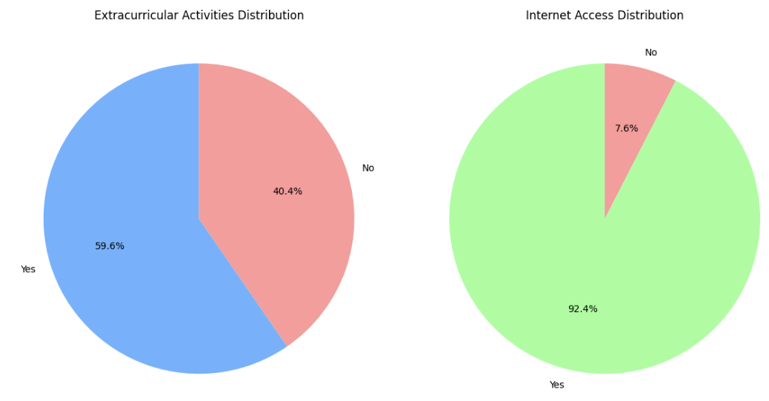
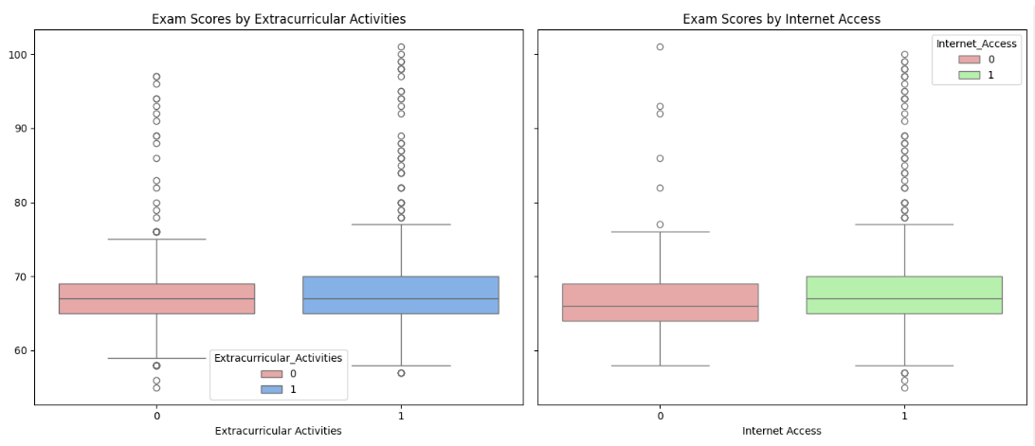
Exploratory Data Visualization (3)
Both internet access and participation in extracurricular activities are associated with higher medians and more outliers
Higher IQRs in positive class suggests that benefit is not equally consistent for all students
It’s likely that these two features won’t have much of an impact on exam scores

Slide 10
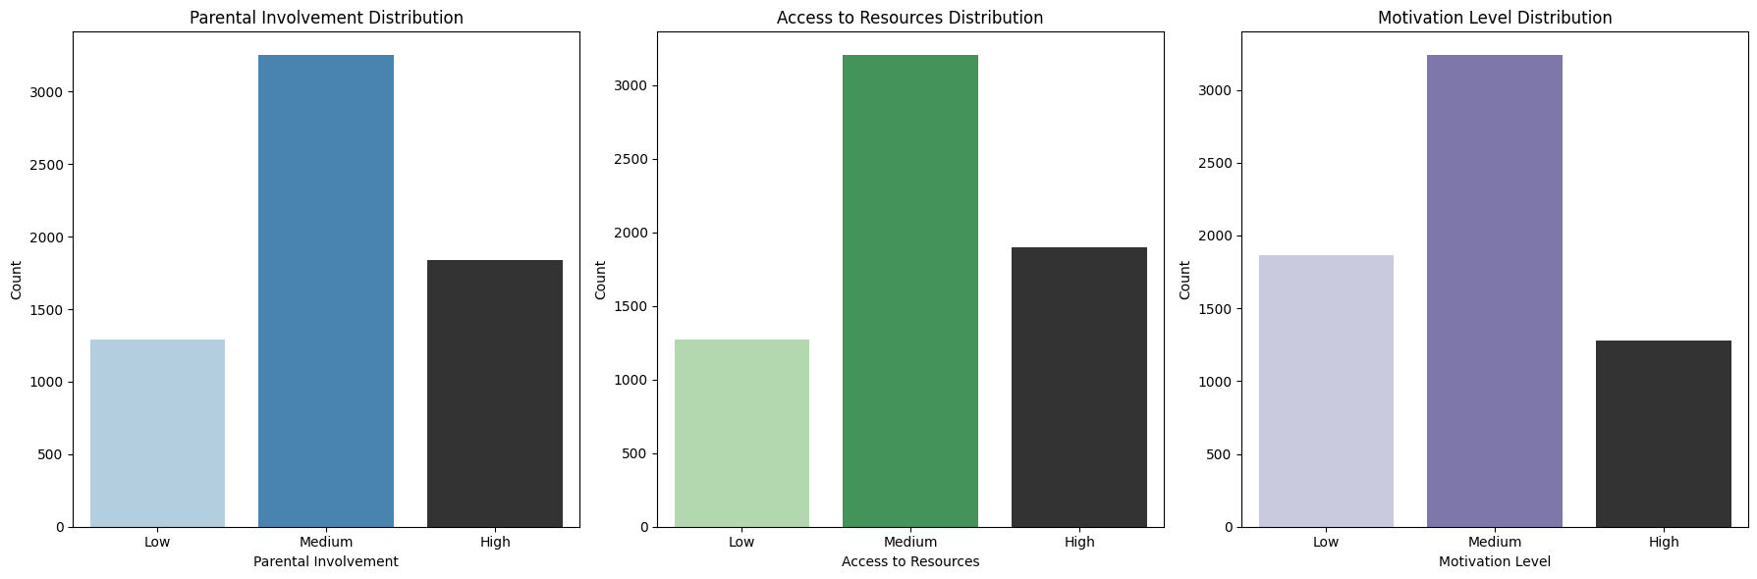
Exploratory Data Visualization (4)
Most participants fall into the medium category across all three factors
High and low extremes are not as common

Slide 11
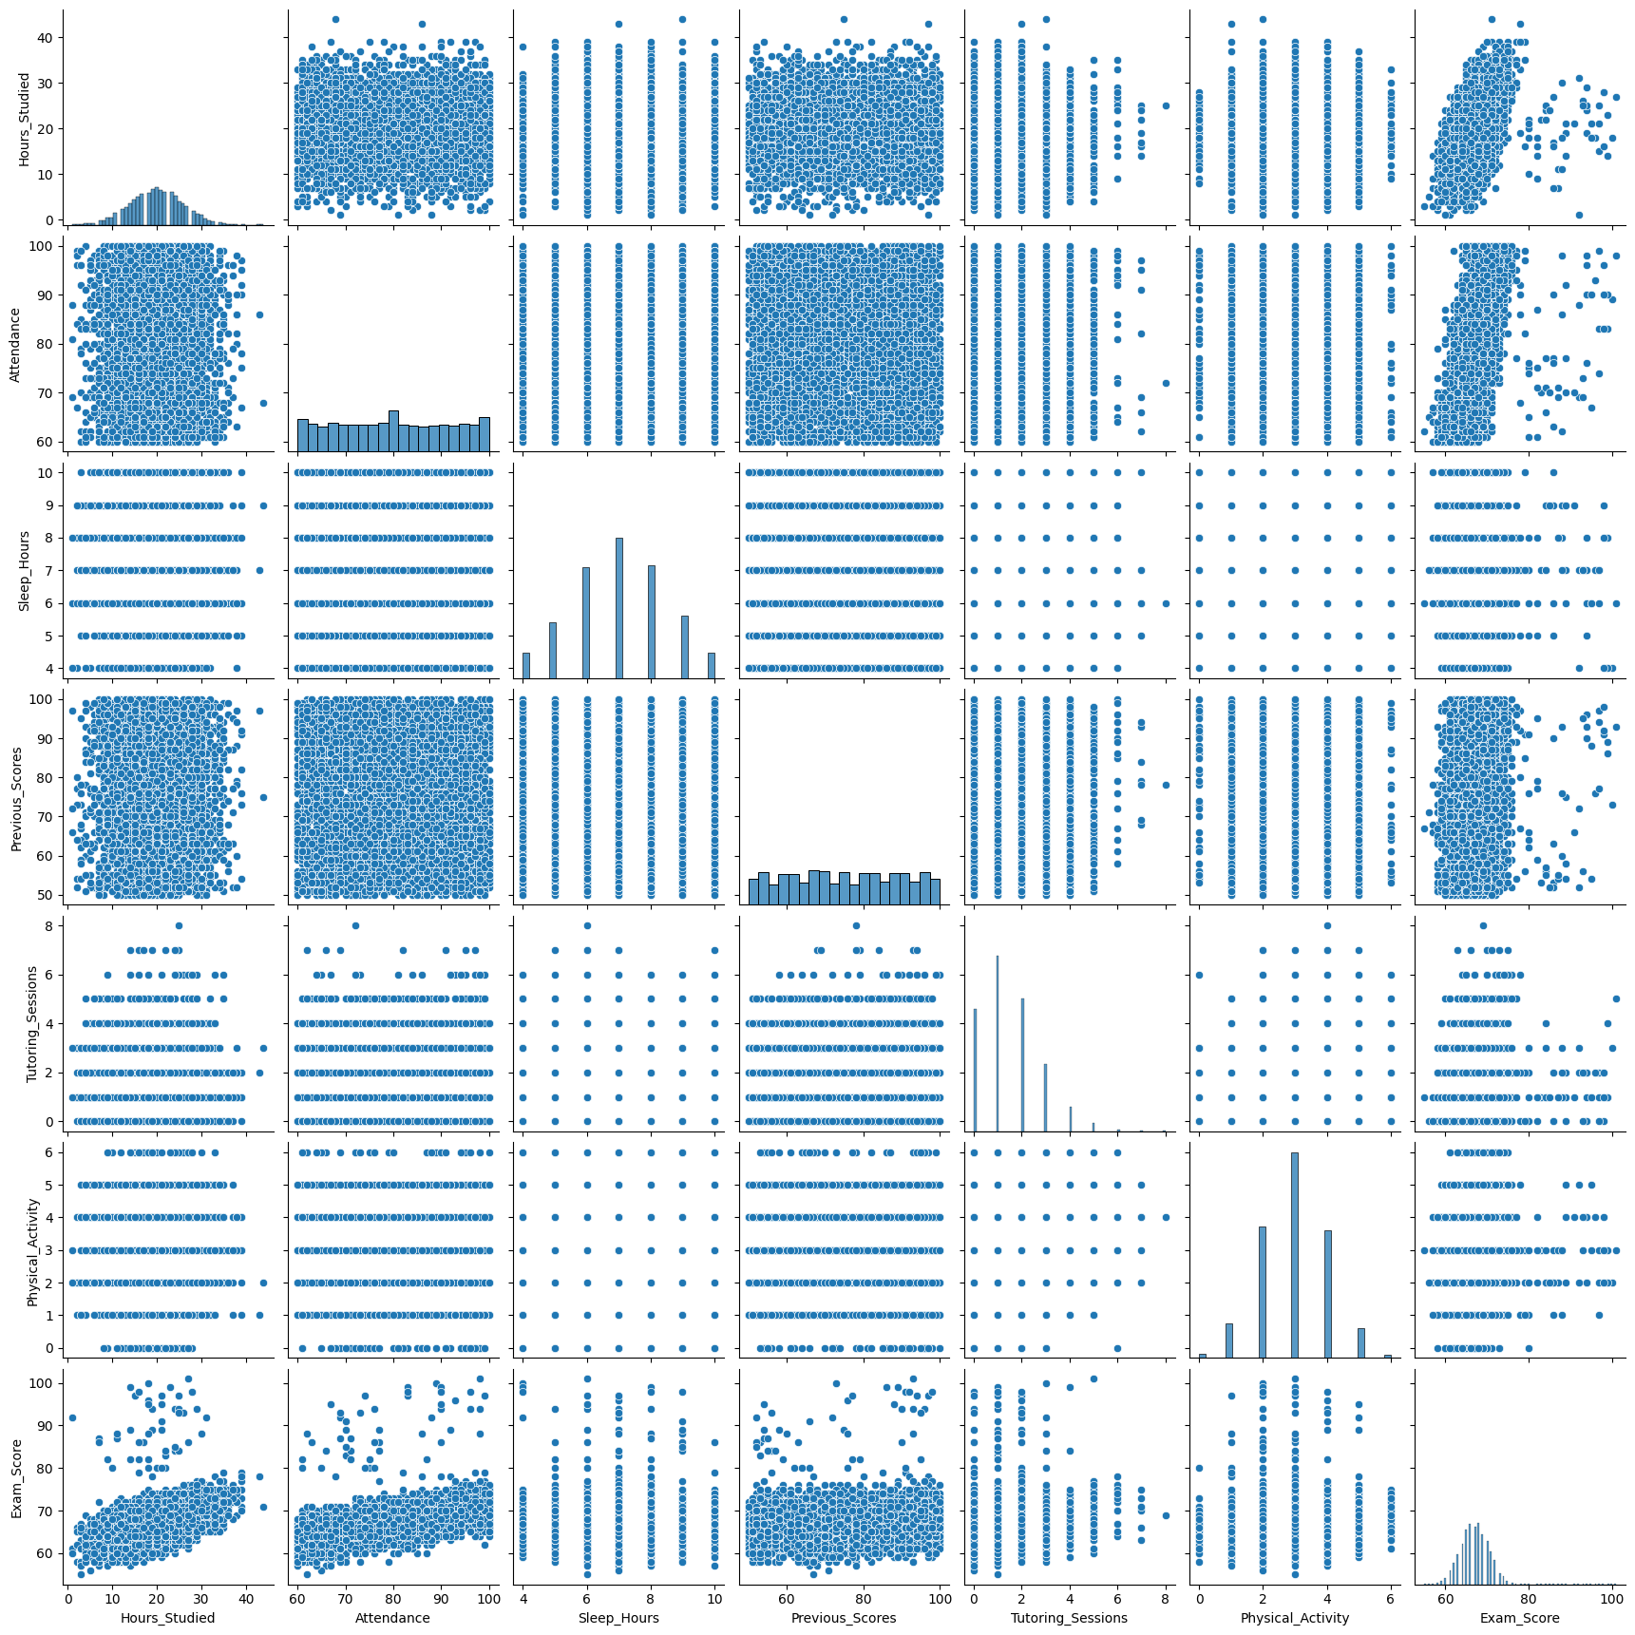
Exploratory Data Visualization (5)
Pairplot (numerical features)
No numerical feature is strong correlated with one another
Only Hours_Studied and Attendance seem to be decently correlated with Exam_Score (Bottom left)

Slide 12
Data Preprocessing and Preparation (1)
Null values found in columns: Teacher_Quality (78), Parental_Education_Level (90), Distance_From_Home (67). These are dropped, they comprise a small proportion of total dataset.
No duplicate values found
Encode categorical features
Example - Binary features mapped 1/0
Gender: Male/Female becomes 1/0
Example - Ordinal encoding (clear order that reflects rank)
Family_Income: Low/Medium/High becomes 0/0.5/1
Numerical features are scaled using StandardScaler
Performance of models when using StandardScaler, on average, was better than when using MinMax

Slide 13
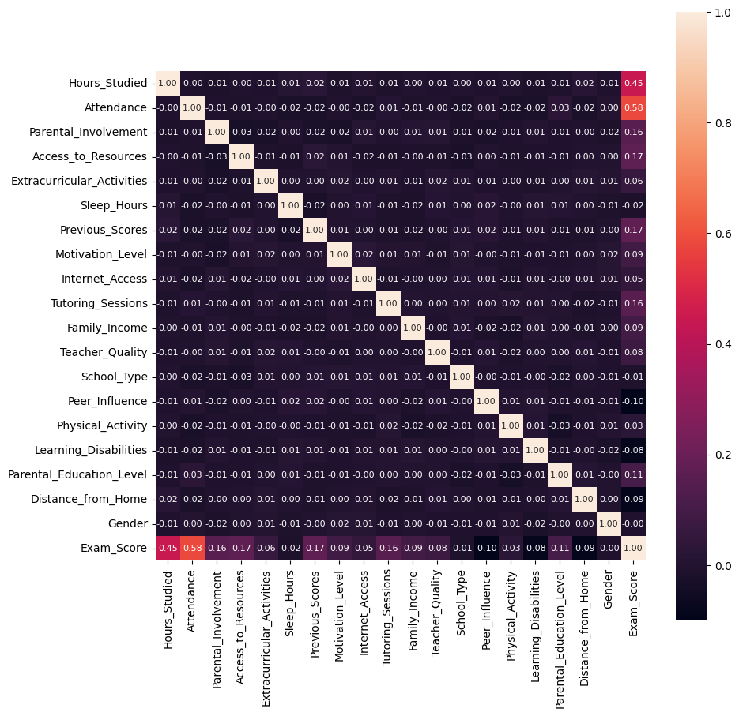
Data Preprocessing and Preparation (2)
Correlations between features and target: only Attendance and Hours_Studied have a notable correlation
No correlation between feature columns
Columns with a correlation less than |0.05| were dropped.
This includes: Sleep hours, School type, Physical Activity and Gender

Slide 14
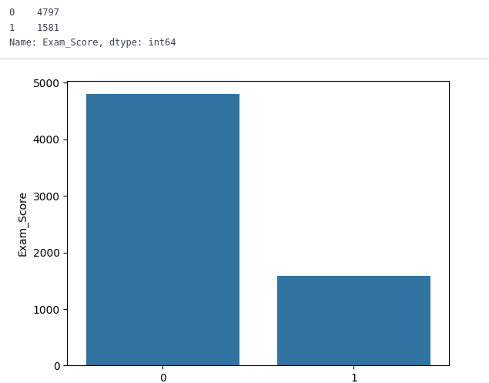
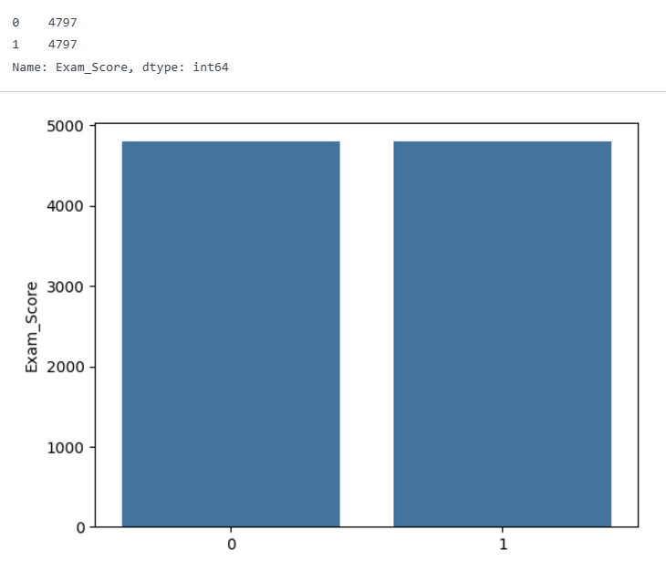
Data Preprocessing and Preparation (3)
Before SMOTE:
In the case of classification, we labeled exam scores above 70 as passing (1) and below that as failing (0)
Exam scores contain an imbalance, with roughly 3x more failing scores than passing
SMOTE is applied to address this, increasing the number of passing training examples (label 1) to equal failing examples (label 0)
Finally, a 80/20 train/test split is used for training all models
After SMOTE:

Slide 15
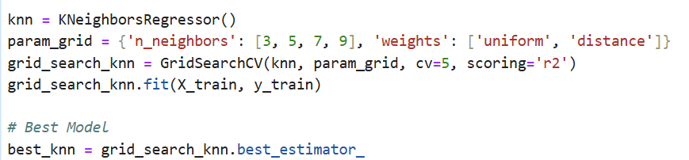
Methodology for Finding Model Parameters
For most scikit-learn models, GridSearchCV was performed locally to optimize the hyperparameters by testing multiple parameter combinations
Often took >15 minutes depending on the model
The best hyperparameters were used when training the models in the cloud notebook
For the Neural Networks, we used the same model structure used in Coding Assignment 4 due to its complexity and ability to detect complex patterns
Used sigmoid activation function for classification and linear activation function for regression in output layer
Used mae loss function for regression and binary_crossentropy loss function for classification
Needed to binarize predictions for classification (>0.5 = 1 and <0.5 = 0)
Notes:
Julian

Slide 16
Experimental Results (Regression)
We compared 10 different models on the same data in order to find the best:
Simple Linear Regression
Linear Regression with L2 Regularization
Linear Regression with L1 Regularization
Decision Tree Regressor
K Neighbors Regressor
Random Forest Regressor
SVM Regressor
Adaboost Regressor
Stacking Regressor (linear regression and SVM)
Neural Network
Notes:
Julian

Slide 17
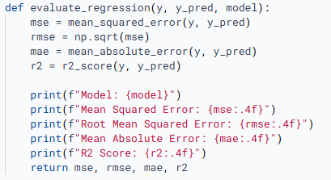
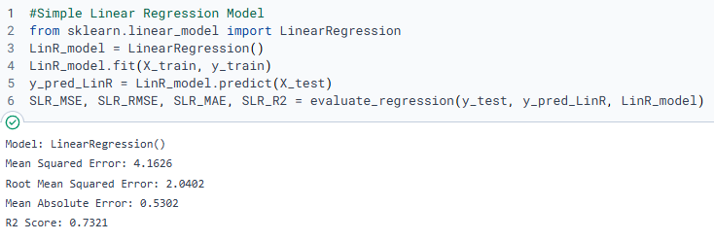
Experimental Results (Regression)
After computing each of the models, they were evaluated with a simple function to retrieve the Mean Squared Error, the Root Mean Squared Error, the Mean Absolute Error, and the R2 Score.
Evaluation Function for regression
Example of using evaluation function on a linear regression
Notes:
Julian

Slide 18
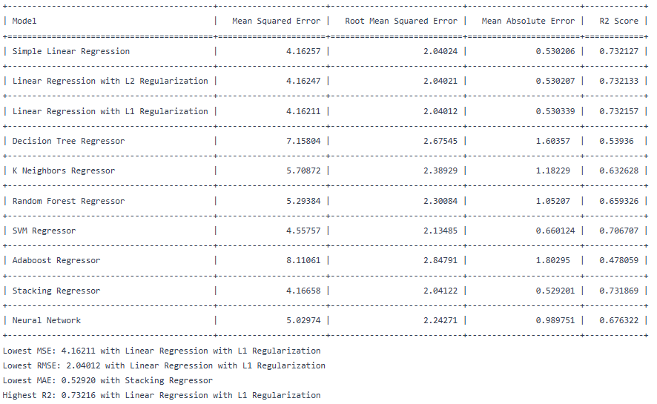
Experimental Results (Regression)
After computing these values for all models. We compared all the values into a table.
Notes:
Julian

Slide 19
Experimental Results (Regression)
-For our dataset, the linear regression models performed the best, hinting that our model was linearly correlated.
-Stacking also performed well, due to the fact that we used a linear model and a svm.
-Adaboost was by far the worst model. Likely because its main mechanism focuses on misclassified points. This could have led to overfitting.
-The Decision tree model didn’t perform well either. This is likely because it creates predictions by dividing the data into regions, which is not well-suited to capture the smooth linear pattern of our data.
Notes:
Julian

Slide 20
Experimental Results (Classification)
We compared 8 different models on the same dataset in order to find which performed best:
Simple Logistic Regression
Decision Tree Classifier
K Nearest Neighbors Classifier
Random Forest Classifier
Support Vector Machine Classifier
Adaboost Classifier
Stacking Classifier (Decision Tree, Logistic Regression, and KNN)
Neural Network Classifier
Reminder: In order to classify this data. We split the data by pass and fail on a grade of 70. We considered anything under 70 a fail and anything 70 and above a pass.

Slide 21
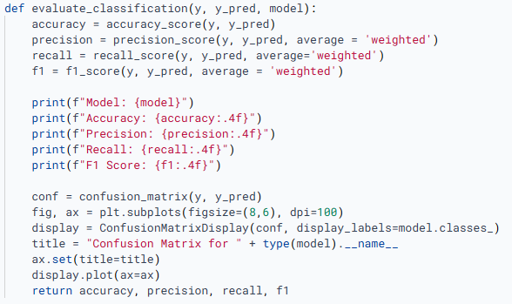
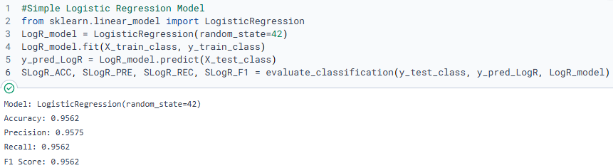
Experimental Results (Classification)
After computing each of the models, they were evaluated with a simple function to retrieve the Accuracy, the Precision, the Recall, and the F1 Score.
Evaluation Function for Classification
Example of using evaluation function on a logistic regression
Included in the evaluation function is a confusion matrix, which will be show on the next page

Slide 22
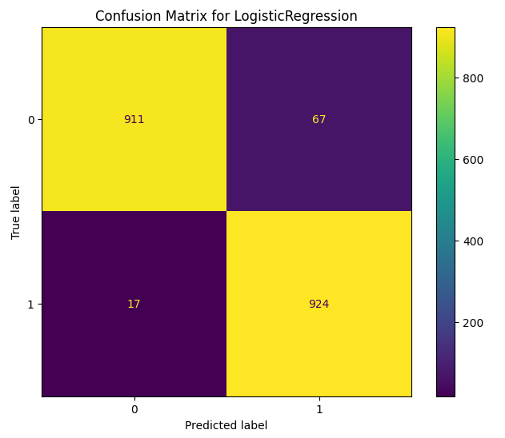
Experimental Results (Classification)
As seen in the previous page, a confusion matrix is generated whilst evaluating each classification model. Here is the confusion matrix for the Logistic Regression model:

Slide 23
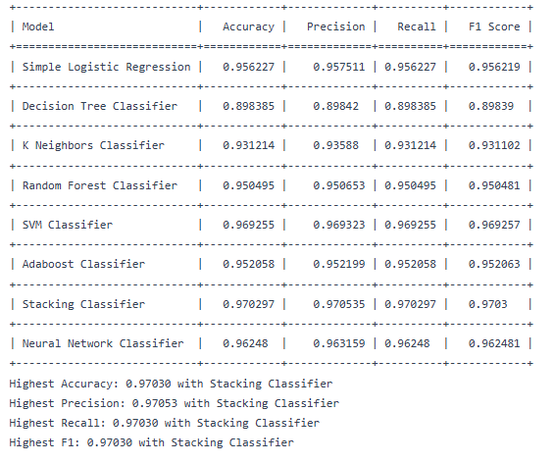
Experimental Results (Classification)
After computing these values for all models. We compared all the values into a table.

Slide 24
Experimental Results (Classification)
-For our dataset, the stacking model outperformed all other across all tracked statistics. Our stacking model combined a decision tree, logistic regression as well as knn.
-SVM performed next best. SVM tries to find the optimal hyperplane do divide the data. This is perfect for a linear dataset (which discovered during regression models) as the nature of it makes it easy to divide.
-The Decision Tree model didn’t perform very well relative to the others. This is likely because it creates non-linear decision boundaries, even though our dataset is best separated by a straight line.
-Overall, our models all performed well, with accuracies above 93% for all but decision tree. This goes to show that our data manipulation prior to evaluating the models was effective at properly identifying and classifying the data.

Slide 25
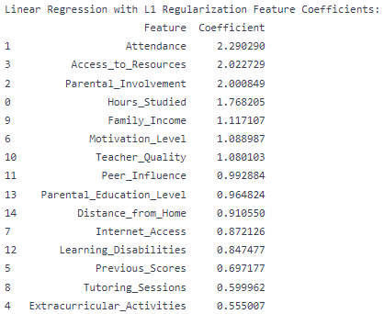
Conclusion (Data Found: Regression)
- After finding the best models, we retrieved the coefficients (or feature importance values) for that model.
- Our most accurate model, Linear Regression with L1 Regularization, uses the Attendance, Access to Resources, and Parental Involvement features the most.
- Since all of our features have similar ranges, this is not due to a difference in scale.
Notes:
Zach

Slide 26

Conclusion (Data Found: Classification)
- Our most accurate model, the Stacking Classifier, doesn’t have direct correlations to features. Instead, it has coefficients for its base learners. The Logistic Regression model was the most influential model, followed shortly by the KNN model.
- Since the KNN model doesn’t directly analyze the features passed to it, we can’t learn anything about the features using this model.
Notes:
Zach

Slide 27
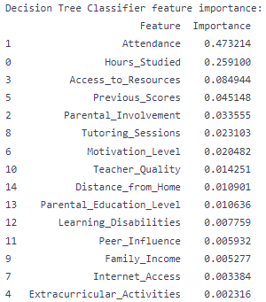
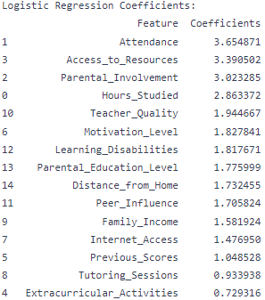
Conclusion (Data Found: Classification cont.)
- Therefore, we can only analyze the Decision Tree Classifier and the Logistic Regression model.
- Both of these models agree that attendance is the most important feature. They both show how access to resources and hours studied are important.
Notes:
Zach

Slide 28
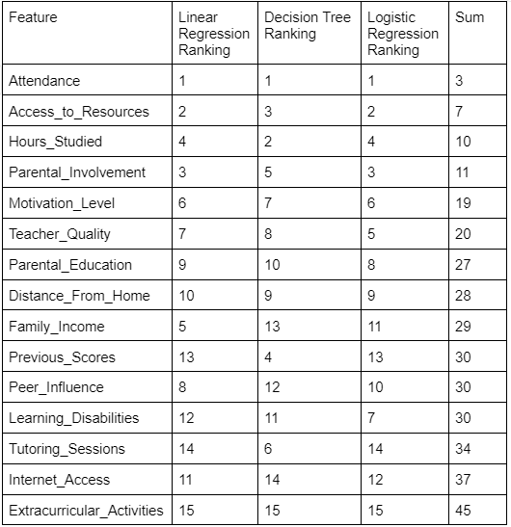
Conclusion (Data Found: Summary)
- By ranking these models, and seeing the most important features, we can come to a conclusion about what the most important features are.
- Overall, Attendance, a student’s access to resources, and the number of hours studied are the most impactful features. Additionally, a student’s involvement with extracurricular activities seem to have the least impact on their exam scores.
Notes:
Zach

Slide 29
Conclusion (Machine Learning)
- When attempting to find trends a set of data, a complicated model isn’t necessarily the most applicable model. Neural Networks are known to find nonlinear trends in data, making them applicable for a lot of scenarios.
- However, as shown with our Linear Regression model, data can be split linearly. Therefore, all types of models must be considered.
Notes:
Zach

